Slide 1
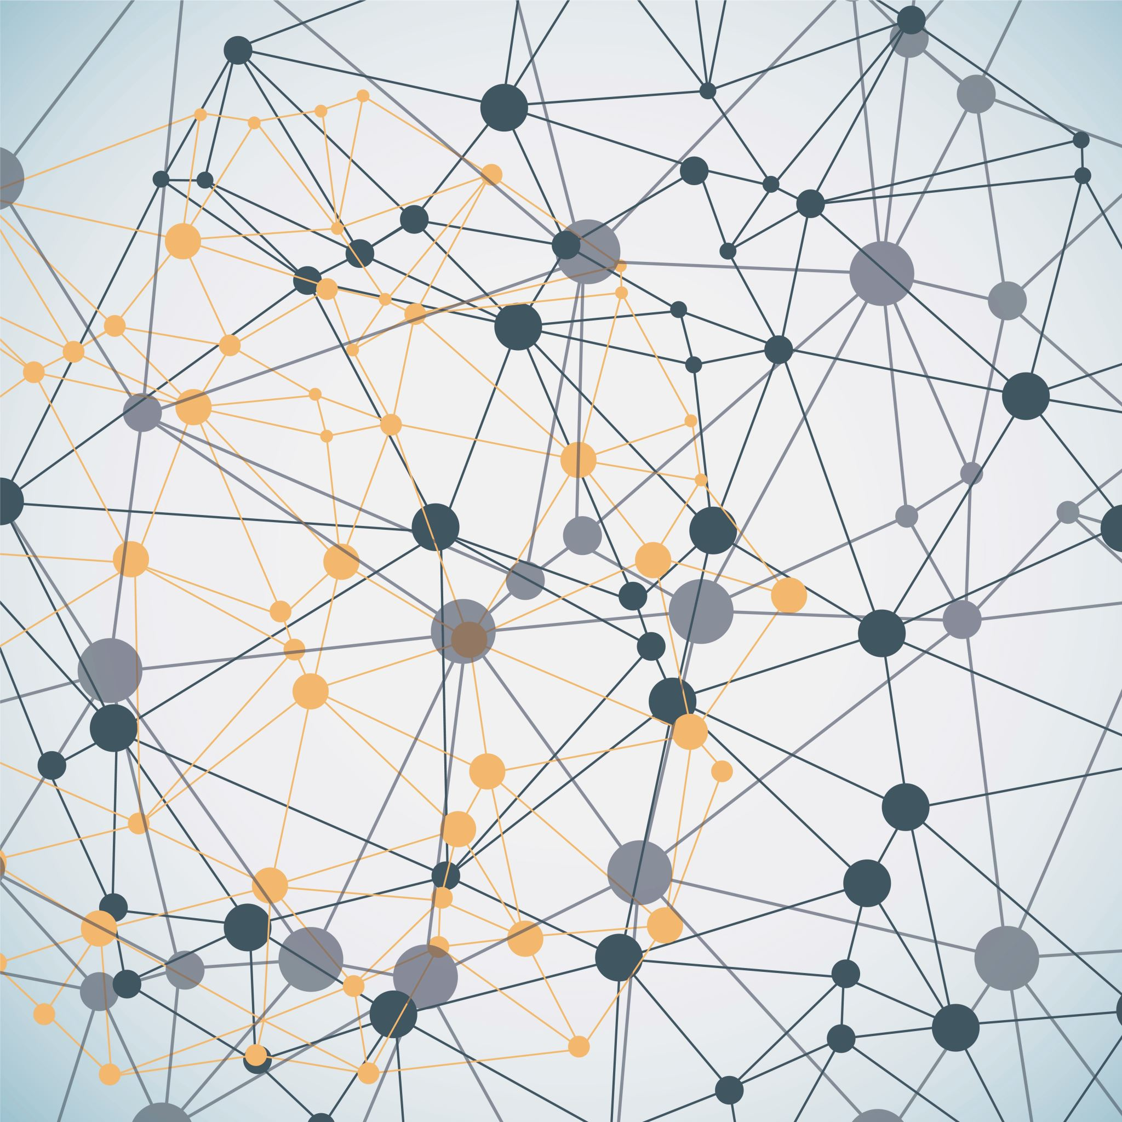
ASL translator
ELLA BAR
NAOMI GREEN
DANIELLA SIMONOVSKY
Deep Learning Workshop

Slide 2

Problem Statement & Scope
Task: Isolated sign (word‑level) classification from video
Motivation: Help deaf and hearing people learn a shared, accessible language
Input: video clip; Output: English word from fixed vocabulary

Slide 3
Dataset & Preprocessing
Datasets: WASL set from Kaggle, short clips by us
Preprocessing: Extract pose keypoints (body, face, hands) from each frame using MediaPipe, normalize (median & deviation), and stack frame data.
Enrichment: Sample mirroring.
Video sample
MediaPipe keypoints
Normalized pose vectors
Finalized sample tensors

Slide 4
Architecture: Keypoint-BiLSTM
Input (B, D, T) → LayerNorm → Linear(1629 → 256)
D = 1629 points of flattened MediaPipe pose data
BiLSTM: hidden 512, 2 layers, bidirectional (for GD), dropout 0.3 (regularization)
Rationale: smaller, faster, appearance-invariant vs. pixel CNNs

Slide 5
Training Setup
Optimizer: Adam, LR [0.001, 0.01] ; grad clipping 5.0 (for stability)
Batch size & epochs: 8 for SGD or entire for GD; around 100 epochs until plateau.
Best checkpoint on highest val metric
DataLoader tuned for runtime (e.g., num_workers=2 on Colab)

Slide 6

Demonstration

Slide 7
Challenges
Lack of data
Available public resources did not contain enough samples for each word
We focused on a few words with as many samples as we could find, but the data was still insufficient
Personal enrichment efforts helped, but their impact was limited
Overfitting
With this amount of data, overfitting was difficult to avoid

Slide 8
Conclusions & Next Steps
MediaPipe helped refine the data and speed up training
Too much weight was given to facial expressions since that is MediaPipe’s focus
Enrich data by an order of magnitude
Reduce weight of facial expressions
Expand vocabulary once more data is available

Slide 9
References
● Fang, Biyi &amp; Co, Jillian &amp; Zhang, Mi. (2017). DeepASL: Enabling Ubiquitous and Non-Intrusive Word and Sentence-Level Sign Language Translation. 10.1145/3131672.3131693.
● Baihan, A., Alutaibi, A.I., Alshehri, M. et al. Sign language recognition using modified deep learning network and hybrid optimization: a hybrid optimizer (HO) based optimized CNNSa-LSTM approach. Sci Rep 14, 26111 (2024). https://doi.org/10.1038/s41598-024-76174-7
● Camgoz, N. C., Koller, O., Hadfield, S., &amp; Bowden, R. (2020). Sign Language Transformers: Joint End-to-end Sign Language Recognition and Translation. In IEEE/CVF Conference on Computer Vision and Pattern Recognition (CVPR)
● M. Madhiarasan, Partha Pratim Roy (2022). A Comprehensive Review of Sign Language Recognition: Different Types, Modalities, and Datasets - https://arxiv.org/abs/2204.03328
● Y. S. Tan, K. M. Lim, and C. P. Lee, “Hand gesture recognition via enhanced densely connected convolutional neural network,”https://www.sciencedirect.com/science/article/pii/S0957417421002384
● R. Rastgoo, K. Kiani, and S. Escalera, “Sign language recognition: A deep survey,” https://doi.org/10.1016/j.eswa.2020.113794

